Slide 1


RAINFALL PREDICTION SYSTEM
By group-d18

Slide 2
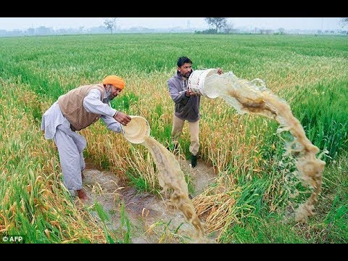
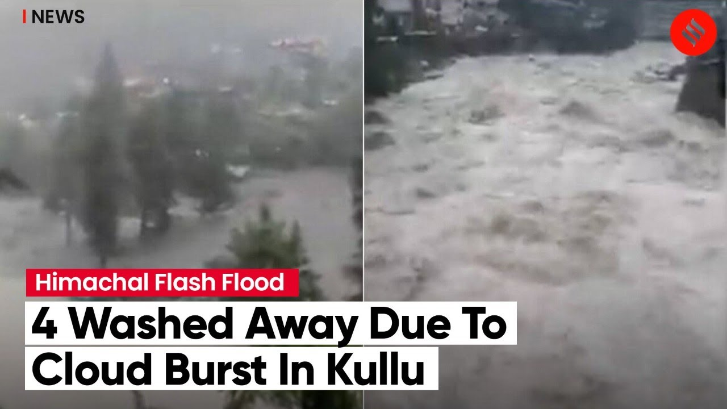
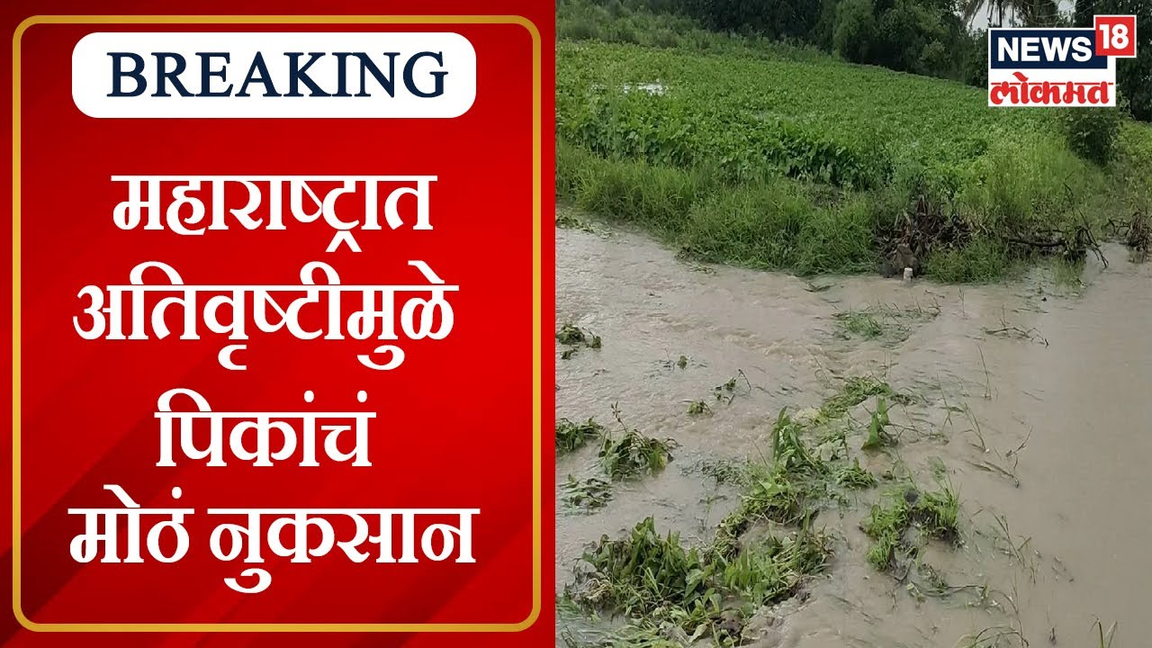
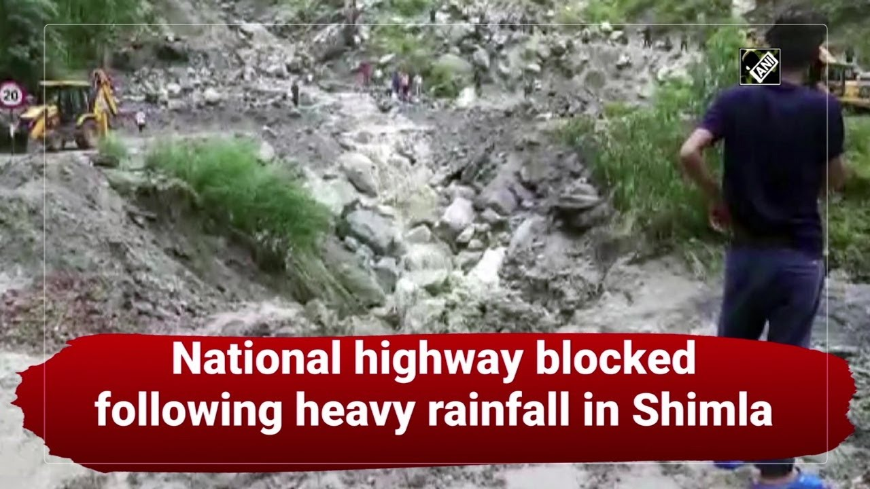
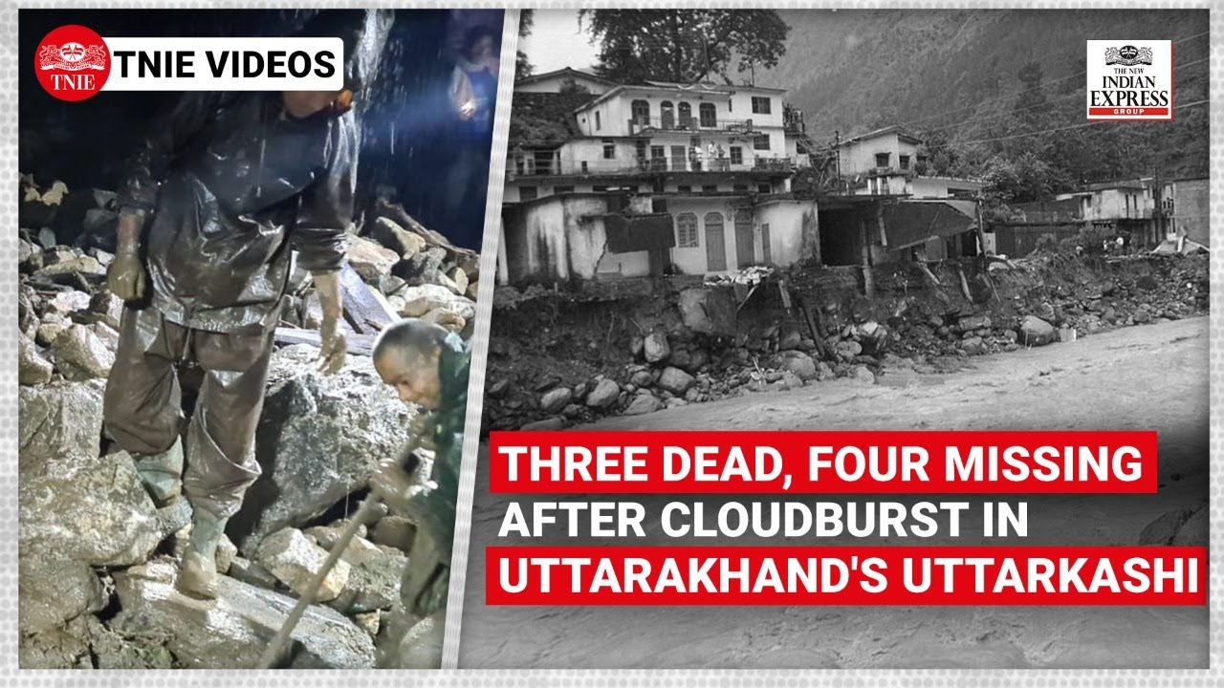

Slide 3
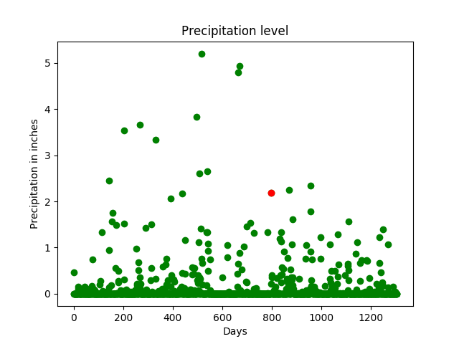
What is RPS?
Rainfall prediction System is a predicting method which will give you the news about rain for three days (that day and upcoming two days). Also, the area in which users want to check the condition of the rain, it also depends upon the user’s choice. This machine is totally based on Machine learning and it will give you its answers by anaylizing last 100 years the data of rain in every area. The dataset which we are going to use is downloaded from Kaggle.

Slide 4

Objective
In India, Agriculture is the key point for survival. For agriculture, rainfall is most important. These days rainfall prediction has become a major problem. Prediction of rainfall gives awareness to people and know in advance about rainfall to take certain precautions to protect their crop from rainfall.
So, it is one of the challenging and uncertain tasks which has a significant impact on human society. Timely and accurate predictions can help to proactively reduce human and financial loss. This study presents a set of experiments which involve the use of prevalent machine learning techniques to build models to predict whether it is going to rain tomorrow or not based on weather data for that particular day in major cities of India.

Slide 5
Methodlogy
For this we will us DATA Collection first, the processed data were collected from the regional meteorological station, Ten data features such as year, month, date, evaporation, sunshine, maximum temperature, minimum temperature, humidity, wind speed, and rainfall were included.
Now, the Data Pre-Processing step included the data conversion, manage missing values, categorical encoding, and splitting dataset for training and testing dataset.
A total of 100 years (1901–2015) data were collected from the meteorology office. Some of the major Machine Learning algorithms are ARIMA Model(Auto-Regressive Integrated Moving Average), Artificial Neural Network, Linear Regression, Support Vector Machine and Self Organizing Map. Two commonly used models predict seasonal rainfall such as Linear and Non-Linear models.

Slide 6



As elements, we are going to use-
As Hardware:-
Rygen-7 Octa-core processor
Monitor
RGB Keyboard and Mouse
As Software:-
OS- Windows 11
Developer Tool- Jupiter
Language- Python
Kaggle for dataset

Slide 7
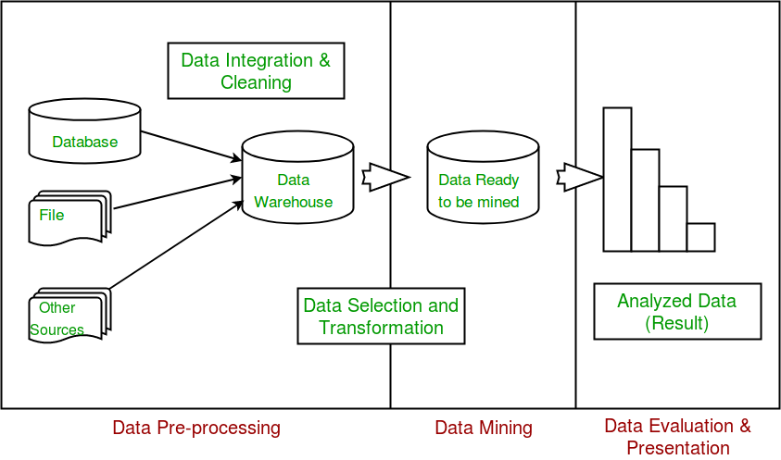
Flowchart

Slide 8
Models used-
Linear Regression Model-
This algorithm will predict the amount of rainfall
It tells us how many inches of rainfall we can expect
Logistics Regression Model-
The use of logistic regression modeling has exploded during the past decade for prediction and forecasting
This algorithms have been used to predict the weather on the basis of minimum and maximum temperatures, wind speed, humidity, precipitation and chances of rainfall
ARIMA Model-
This algorithm used for time series analysis and future forecasting
This algorithm provides managers with reliable guidelines in making decisions related to supply chains

Slide 9
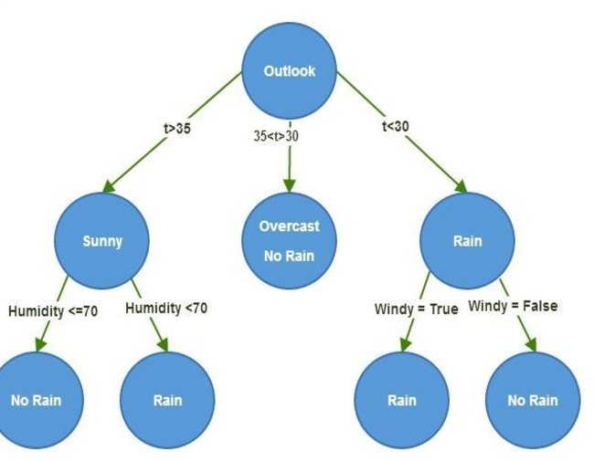
Descision Tree Model-
This model reduce the uncertainty involved in estimating the associated hydrological variables such as runoff, infiltration, and stream flow

Slide 10
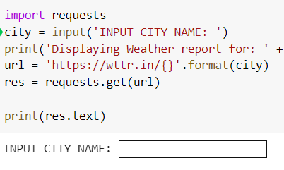
INPUT MENU-
Here is the input menu of our model, at “INPUT CITY NAME” in which you can enter the city name of that city you want to know,,

Slide 11
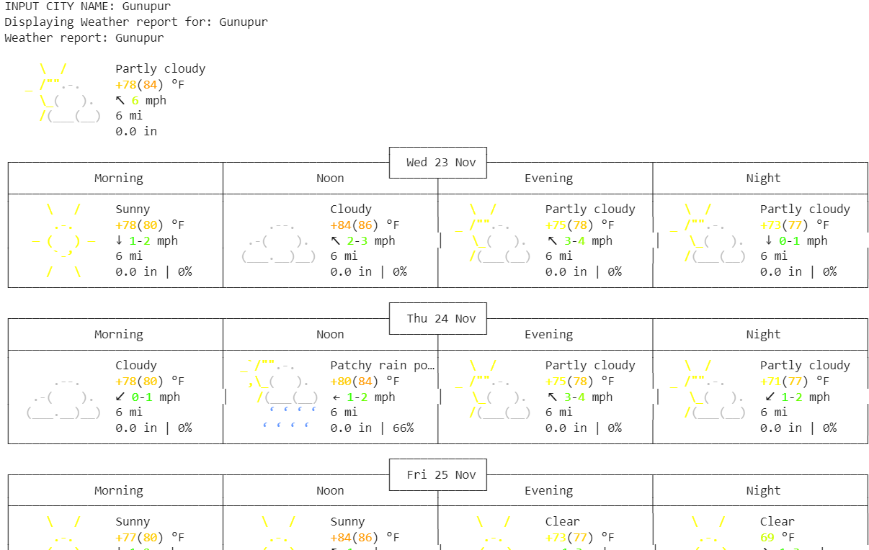
Code Output-

Slide 12


